Slide 1

Decision Trees
Jayanth Rasamsetti
Founder & Chief Scientist
www.sgmoid.com
Columbia University (MS)
IIT Madras (B.Tech & M.Tech)
jr3281@columbia.edu
https://www.linkedin.com/in/jayanthr/

Slide 2
Agenda:
Google Colaboratory, AWS Sagemaker
Day 1: Decision Trees, Gini/Entropy, Ensemble methods [credit.csv, heart.csv]
Test
Day 2: Bagging, Bagged Decision Trees, Random Forests
Test
Day 3: Boosting, Adaboost, Gradient Boosting,

Slide 3

Best Practices:
We will be very hands on! Blend of theory & lab
Very important to code every day 20 lines of Python code
Introduction to Google Colab (https://colab.research.google.com/notebook)
De-bug as much as possible every line of code
10 min rule: Try to debug for 10 min independently (either stack overflow, etc) and only then seek help (from a peer)
Tips to improve coding: Pair programming, long hours, competitions
Avoid copy pasting!

Slide 4

Case Method Style of teaching:
Traditional Method:
Concept > Exercise
Pros: Linear Flow
Cons: Dependent thinking, Fallacy in structure
Case Study > Solve Exercise
Pros: Independent thinking, Research, similar to most real life problems
Failing is good! Independent problem solving is better!
Fail fast! Iterate faster! Debug faster!

Slide 5
Debug Checklist:
Spelling mistakes
Case sensitive, Parenthesis ( { [
Correct path to the dataset
Input libraries
Variable names
Indentation
Syntax
Shape mismatch
Type mismatch (numpy arrays)
Stackoverflow

Slide 6
Debug Checklist:
Follow the checklist to the letter
Look at the line number where the code broke
Search appropriately in Google the error
Look at stackoverflow, most people have similar errors
Read highly voted Stackoverflow comments only
Outcomes:
Atleast 30 lines of Python code/day. Debugged 10 errors. Independently.
Basic + Bonus. Outline of Machine Learning.
Positive Frame of mind and ready for the next steps (Decision Trees, Random Forests, Neural Networks)
Competitive Coding (Kaggle); Academic Research (IISc/IIIT/PGSSP), Startup

Slide 7
What is a decision tree?
Lets Play a Game: Guess the Animal
I am thinking of an Animal. You can ask a set of questions (on features of the animal)
Can you guess the animal based on my answers?
Conditions:
Only Yes/No questions or questions on a single attribute No questions based on the animal name itself
Let’s begin!

Slide 8
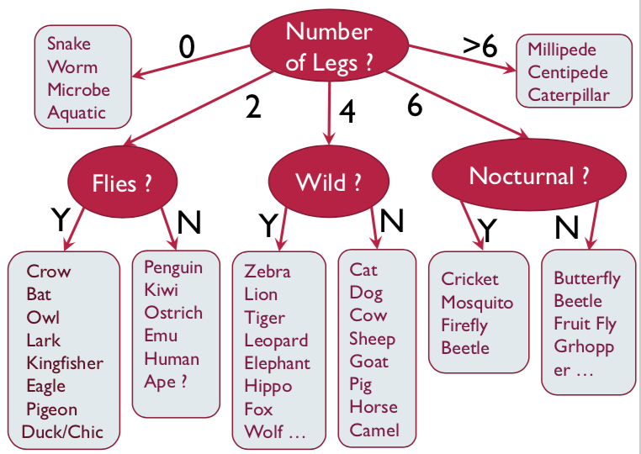
Guess the animal
Questions
1) How many legs?
2) Does it fly?
3) Wild animal?
4) Nocturnal?
5) Fur/Feather?
6) Farm Animal?

Slide 9
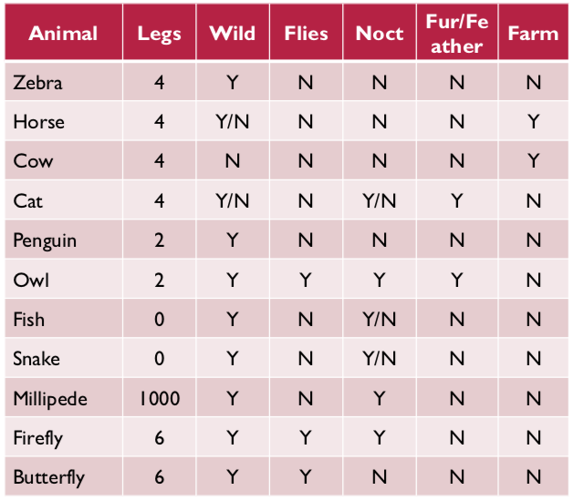
Larger Picture
1) We have lots of possible animals
2) Each has a set of attributes
3) Look at 1 attribute at a time
4) Narrow down the class label

Slide 10
What are we doing? (Larger Picture)
Goal
Arrive at a single class label
Can we learn the tree?
“Which question to ask at any point?”

Slide 11

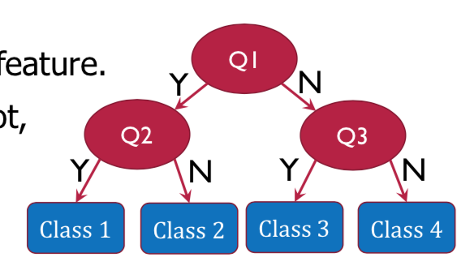
Decision Trees: Summary. Steps
At each step, ask the question that minimizes uncertainty (entropy)
Once the set contains only a single class, label it
The sequence of questions/decisions can be represented as a tree:
The Decision Tree
Each question is on a single feature
Tree Terms: Node, Edge, Root, Leaf, Depth, Height, Path, Parent, Child

Slide 12
Decision Trees
What is the best ways to split? (Mathematically?)
Entropy

Slide 13
Decision Trees
What is the best ways to split? (Mathematically?)
 | Gender | Smokes
Healthy | 5 | 6
Cancer | 5 | 4

Slide 14
Decision Trees
What is the best ways to split? (Mathematically?)
 | Gender | Smokes
Healthy | 9 | 6
Cancer | 1 | 4

Slide 15
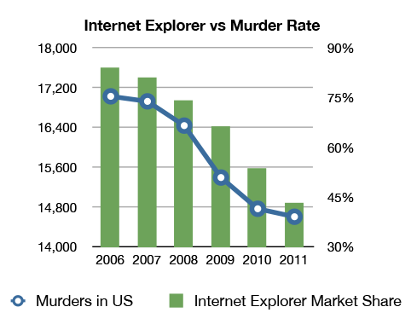
Caution: Correlation need not imply causation!

Slide 16
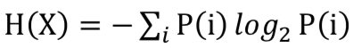
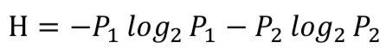
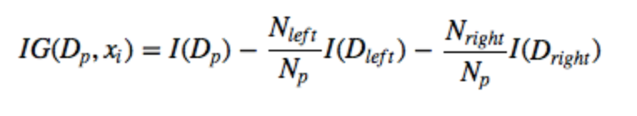
What is Entropy?
1. Is a measure of Uncertainty
2. Assume a set contains two classes
3. Information Gain / Loss function
Information Gain is the Entropy/Gini of the parent node minus the entropy/gini of the child nodes

Slide 17
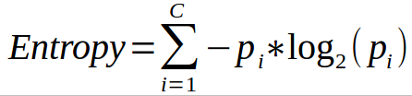
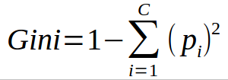
Common measures of purity
Entropy:
Favors splits with small counts but many unique values
Weights probability of class by log(base=2) of the class probability
A smaller value of Entropy is better. That makes the difference between the parent node’s entropy larger
Gini:
Subtract the sum of the squared probabilities of each class from one
Uses squared proportion of classes
Perfectly classified, Gini Index would be zero
Evenly distributed would be 1 – (1/# Classes)
You want a variable split that has a low Gini Index
Used in CART algorithm

Slide 18
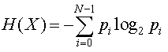
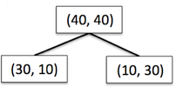
Information Gain using Entropy

Slide 19
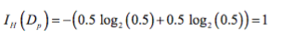
Information Gain using Entropy

Slide 20
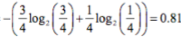
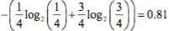
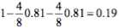
Information Gain using Entropy
Information Gain = reduction in entropy =

Slide 21
Information Gain using Gini index

Slide 22
Information Gain using Gini index

Slide 23
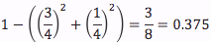
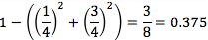
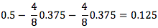
Information Gain using Gini index
Information Gain = reduction in Gini index =

Slide 24
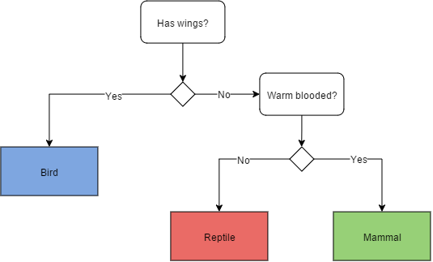
Decision Trees (Classification)
For classification problem, the posterior probability of all the classes is reflected in the leaf node and the Leaf Node belongs to the majority class
After executing all the functions from Root Node to Leaf Node, the class of a data point is decided by the leaf node to which it reaches

Slide 25
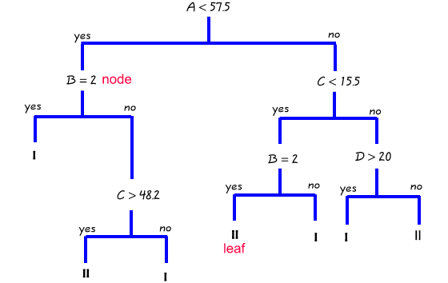
Decision Trees (Regression)
For regression, the average/ median value of the target attribute is assigned to the query variable
Tree creation splits data into subsets and subsets into further smaller subsets. The algorithm stops splitting data when data within the subsets are sufficiently homogenous or some other stopping criterion is met

Slide 26
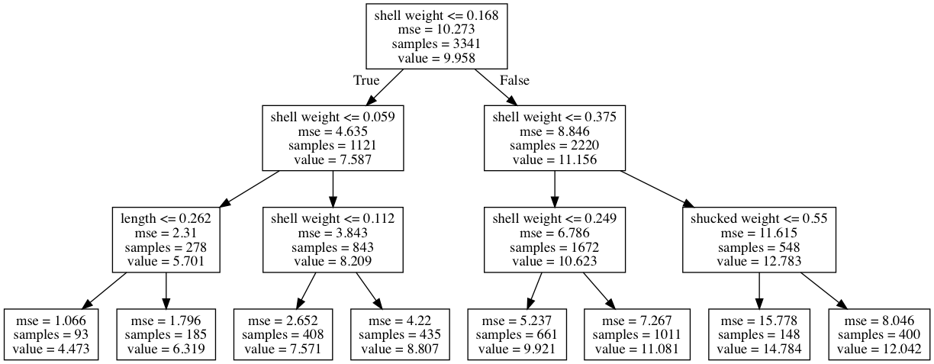
Loss Function (Different from our SSE!)
The decision tree algorithm learns (i.e. creates the decision tree from the data set) through optimization of a loss function
The loss function represents the loss of impurity in the target column. The requirement here is to minimize the impurity as much as possible at the leaf nodes
Purity of a node is a measure of homogeneity in the target column at that node

Slide 27

Decision Trees: Recently Asked Interview Question
Decision tree only works for classification algorithms
True
False

Slide 28
Decision Trees: Recently Asked Interview Question
Decision tree only works for classification algorithms
True
False
Ans) False

Slide 29
Common Algorithms (Applicable to both R and Python)
ID3 (Iterative Dichotomiser 3) (Author: Quinian) Creates a multi branch tree at each node using greedy algorithm. Trees grow to maximum size before pruning
C4.5 succeeded ID3 by overcoming limitation of features required to be categorical. It dynamically defines discrete attribute for numerical attributes. It converts the trained trees into a set of if-then rules. Accuracy of each rule is evaluated to determine the order in which they should be applied
C5.0 is Quinlan’s latest version and it uses less memory and builds smaller rulesets than C4.5 while being more accurate

Slide 30
CART (Classification & Regression Trees)
Similar to C4.5 but it supports numerical target variables and does not compute rule sets. Creates binary tree
Scikit uses CART

Slide 31
Decision Trees
Advantages:
Simple, Fast in processing and effective
Can deal with missing data, handles numeric and categorical variables
Interpretation of results does not require mathematical or statistical knowledge
Disadvantages
Often biased towards splits or features have large number of levels
Small changes in training data can result in large changes to the logic
Large trees can be difficult to interpret

Slide 32
Preventing overfitting through tuning (hyper parameters)
Decision trees do not assume a particular form of relationship between the independent and dependent variables unlike linear models
DT is a non-parameterized algorithm unlike linear models where we supply the input parameters
If left unconstrained, they can build tree structures to adapt to the training data leading to overfitting
To avoid overfitting, we need to restrict the DT’s freedom during the tree creation. This is called regularization
The regularization hyperparameters depend on the algorithms used

Slide 33
Decision trees are notorious for overfitting. Solutions:
1. Early Stopping
2. Do not split a not beyond a point (of number of items or purity)
3. Pruning Once the tree is formed, remove weakest branches. Use validation set to decide when to stop
4. Both approaches also reduces the depth and improves classification speed

Slide 34
Decision Tree Hyper parameters
max_depth – Is the maximum length of a path from root to leaf (in terms of number of decision points. The leaf node is not split further. It could lead to a tree with leaf node containing many observations on one side of the tree, whereas on the other side, nodes containing much less observations get further split
min_sample_split - A limit to stop further splitting of nodes when the number of observations in the node is lower than this value
min_sample_leaf – Minimum number of samples a leaf node must have. When a leaf contains too few observations, further splitting will result in overfitting (modeling of noise in the data).

Slide 35
min_weight_fraction_leaf – Same as min_sample_leaf but expressed in fraction of total number of weighted instances
max_leaf_nodes – maximum number of leaf nodes in a tree
max_feature_size - max number of features that are evaluated for splitting each node

Slide 36

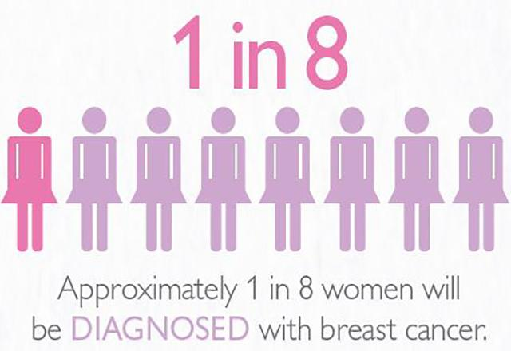
Case Study: Approximately 1 in 8 women will be diagnosed with Breast Cancer. You are hired as a Data Scientist by the Wisconsin Hospital Association to help screen patients in rural areas. How do we go about building the classifier?
Notes:
Attribute 1: (qualitative) Status of existing checking account A11 : ... < 0 DM A12 : 0 <= ... < 200 DM A13 : ... >= 200 DM / salary assignments for at least 1 year A14 : no checking account Attribute 2: (numerical) Duration in month Attribute 3: (qualitative) Credit history A30 : no credits taken/ all credits paid back duly A31 : all credits at this bank paid back duly A32 : existing credits paid back duly till now A33 : delay in paying off in the past A34 : critical account/ other credits existing (not at this bank) Attribute 4: (qualitative) Purpose A40 : car (new) A41 : car (used) A42 : furniture/equipment A43 : radio/television A44 : domestic appliances A45 : repairs A46 : education A47 : (vacation - does not exist?) A48 : retraining A49 : business A410 : others Attribute 5: (numerical) Credit amount Attibute 6: (qualitative) Savings account/bonds A61 : ... < 100 DM A62 : 100 <= ... < 500 DM A63 : 500 <= ... < 1000 DM A64 : .. >= 1000 DM A65 : unknown/ no savings account Attribute 7: (qualitative) Present employment since A71 : unemployed A72 : ... < 1 year A73 : 1 <= ... < 4 years A74 : 4 <= ... < 7 years A75 : .. >= 7 years Attribute 8: (numerical) Installment rate in percentage of disposable income Attribute 9: (qualitative) Personal status and sex A91 : male : divorced/separated A92 : female : divorced/separated/married A93 : male : single A94 : male : married/widowed A95 : female : single Attribute 10: (qualitative) Other debtors / guarantors A101 : none A102 : co-applicant A103 : guarantor Attribute 11: (numerical) Present residence since Attribute 12: (qualitative) Property A121 : real estate A122 : if not A121 : building society savings agreement/ life insurance A123 : if not A121/A122 : car or other, not in attribute 6 A124 : unknown / no property Attribute 13: (numerical) Age in years Attribute 14: (qualitative) Other installment plans A141 : bank A142 : stores A143 : none Attribute 15: (qualitative) Housing A151 : rent A152 : own A153 : for free Attribute 16: (numerical) Number of existing credits at this bank Attribute 17: (qualitative) Job A171 : unemployed/ unskilled - non-resident A172 : unskilled - resident A173 : skilled employee / official A174 : management/ self-employed/ highly qualified employee/ officer Attribute 18: (numerical) Number of people being liable to provide maintenance for Attribute 19: (qualitative) Telephone A191 : none A192 : yes, registered under the customers name Attribute 20: (qualitative) foreign worker A201 : yes A202 : no

Slide 37
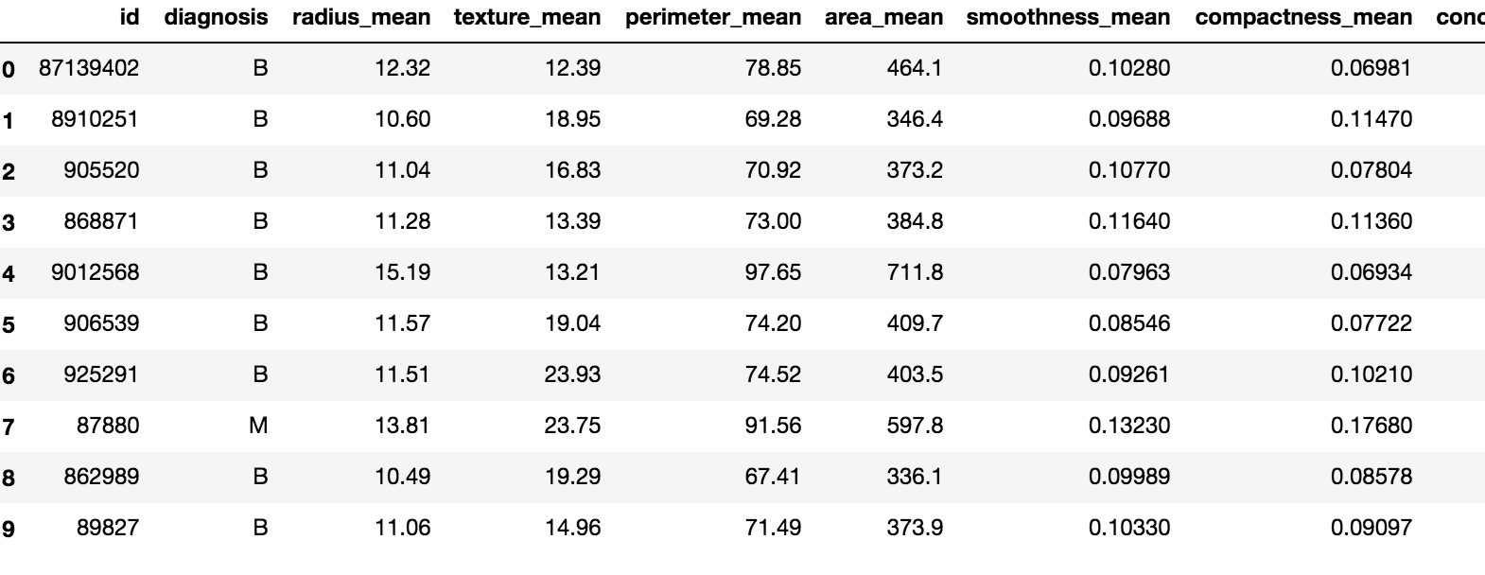
569 rows and 32 columns
Benign (Healthy) Malignant (Cancer)
Notes:
Attribute 1: (qualitative) Status of existing checking account A11 : ... < 0 DM A12 : 0 <= ... < 200 DM A13 : ... >= 200 DM / salary assignments for at least 1 year A14 : no checking account Attribute 2: (numerical) Duration in month Attribute 3: (qualitative) Credit history A30 : no credits taken/ all credits paid back duly A31 : all credits at this bank paid back duly A32 : existing credits paid back duly till now A33 : delay in paying off in the past A34 : critical account/ other credits existing (not at this bank) Attribute 4: (qualitative) Purpose A40 : car (new) A41 : car (used) A42 : furniture/equipment A43 : radio/television A44 : domestic appliances A45 : repairs A46 : education A47 : (vacation - does not exist?) A48 : retraining A49 : business A410 : others Attribute 5: (numerical) Credit amount Attibute 6: (qualitative) Savings account/bonds A61 : ... < 100 DM A62 : 100 <= ... < 500 DM A63 : 500 <= ... < 1000 DM A64 : .. >= 1000 DM A65 : unknown/ no savings account Attribute 7: (qualitative) Present employment since A71 : unemployed A72 : ... < 1 year A73 : 1 <= ... < 4 years A74 : 4 <= ... < 7 years A75 : .. >= 7 years Attribute 8: (numerical) Installment rate in percentage of disposable income Attribute 9: (qualitative) Personal status and sex A91 : male : divorced/separated A92 : female : divorced/separated/married A93 : male : single A94 : male : married/widowed A95 : female : single Attribute 10: (qualitative) Other debtors / guarantors A101 : none A102 : co-applicant A103 : guarantor Attribute 11: (numerical) Present residence since Attribute 12: (qualitative) Property A121 : real estate A122 : if not A121 : building society savings agreement/ life insurance A123 : if not A121/A122 : car or other, not in attribute 6 A124 : unknown / no property Attribute 13: (numerical) Age in years Attribute 14: (qualitative) Other installment plans A141 : bank A142 : stores A143 : none Attribute 15: (qualitative) Housing A151 : rent A152 : own A153 : for free Attribute 16: (numerical) Number of existing credits at this bank Attribute 17: (qualitative) Job A171 : unemployed/ unskilled - non-resident A172 : unskilled - resident A173 : skilled employee / official A174 : management/ self-employed/ highly qualified employee/ officer Attribute 18: (numerical) Number of people being liable to provide maintenance for Attribute 19: (qualitative) Telephone A191 : none A192 : yes, registered under the customers name Attribute 20: (qualitative) foreign worker A201 : yes A202 : no

Slide 38
569 rows and 32 columns
Decision Tree: 87.5 (max_depth: 1)
Decision Tree: ? (Change max_depth: 3)
Notes:
Attribute 1: (qualitative) Status of existing checking account A11 : ... < 0 DM A12 : 0 <= ... < 200 DM A13 : ... >= 200 DM / salary assignments for at least 1 year A14 : no checking account Attribute 2: (numerical) Duration in month Attribute 3: (qualitative) Credit history A30 : no credits taken/ all credits paid back duly A31 : all credits at this bank paid back duly A32 : existing credits paid back duly till now A33 : delay in paying off in the past A34 : critical account/ other credits existing (not at this bank) Attribute 4: (qualitative) Purpose A40 : car (new) A41 : car (used) A42 : furniture/equipment A43 : radio/television A44 : domestic appliances A45 : repairs A46 : education A47 : (vacation - does not exist?) A48 : retraining A49 : business A410 : others Attribute 5: (numerical) Credit amount Attibute 6: (qualitative) Savings account/bonds A61 : ... < 100 DM A62 : 100 <= ... < 500 DM A63 : 500 <= ... < 1000 DM A64 : .. >= 1000 DM A65 : unknown/ no savings account Attribute 7: (qualitative) Present employment since A71 : unemployed A72 : ... < 1 year A73 : 1 <= ... < 4 years A74 : 4 <= ... < 7 years A75 : .. >= 7 years Attribute 8: (numerical) Installment rate in percentage of disposable income Attribute 9: (qualitative) Personal status and sex A91 : male : divorced/separated A92 : female : divorced/separated/married A93 : male : single A94 : male : married/widowed A95 : female : single Attribute 10: (qualitative) Other debtors / guarantors A101 : none A102 : co-applicant A103 : guarantor Attribute 11: (numerical) Present residence since Attribute 12: (qualitative) Property A121 : real estate A122 : if not A121 : building society savings agreement/ life insurance A123 : if not A121/A122 : car or other, not in attribute 6 A124 : unknown / no property Attribute 13: (numerical) Age in years Attribute 14: (qualitative) Other installment plans A141 : bank A142 : stores A143 : none Attribute 15: (qualitative) Housing A151 : rent A152 : own A153 : for free Attribute 16: (numerical) Number of existing credits at this bank Attribute 17: (qualitative) Job A171 : unemployed/ unskilled - non-resident A172 : unskilled - resident A173 : skilled employee / official A174 : management/ self-employed/ highly qualified employee/ officer Attribute 18: (numerical) Number of people being liable to provide maintenance for Attribute 19: (qualitative) Telephone A191 : none A192 : yes, registered under the customers name Attribute 20: (qualitative) foreign worker A201 : yes A202 : no

Slide 39
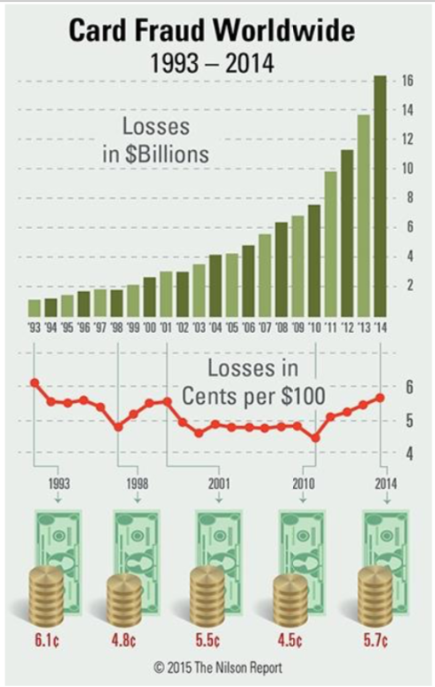
Credit Card Fraud Detection
An e-commerce site has been offered a fraud detection system promising high accuracy. It correctly catches 99% of fraudulent transactions and incorrectly flags 1% of honest transactions as fraudulent.
Source: http://www.nilsonreport.com/publication_chart_and_graphs_archive.php?1=1&year=2015 Last accessed: October 16, 2015

Slide 40
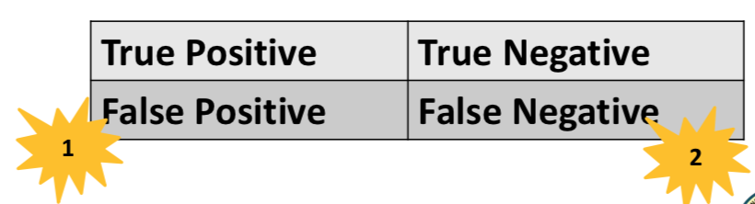
Credit Card Fraud Detection
1) What will be the implications to the retailer of mistaking honest transactions as fraudulent?
2) What will be the implications to the retailer of mistaking fraudulent transactions as honest?
3) What types of errors are the above two? Which one is more critical to the business?

Slide 41
Credit Card Fraud Detection
What conditional probabilities are given? What others are important for business?
Given: P(Flagged fraud | Fraud) = 0.99
P(Flagged fraud | Honest) = 0.01
Other important conditional probabilities:
P(Fraud | Flagged fraud)
P(Honest | Not flagged fraud)

Slide 42
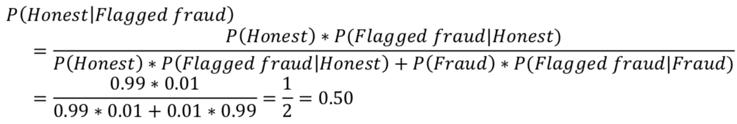
Credit Card Fraud Detection
Suppose 1% of the transactions at the e-commerce site are fraudulent. What are the chances that the transaction is honest given the system has incorrectly flagged it as fraudulent?
To calculate:
P(Honest | Flagged fraud) when P(Fraud) = 0.01

Slide 43
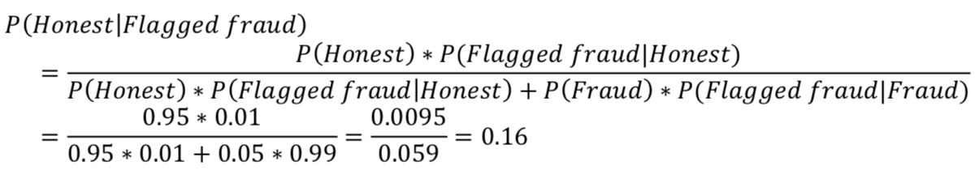
Credit Card Fraud Detection
Suppose 5% of the transactions at the e-commerce site are fraudulent. What are the chances that the transaction is honest given the system has incorrectly flagged it as fraudulent?
To calculate:
P(Honest | Flagged fraud) when P(Fraud) = 0.05

Slide 44
Credit Card Fraud Detection
What is your evaluation of the system? Is it adequate for the e- commerce site’s needs?
If fraud is rare (1% or less), too many honest transactions are labeled as fraud. This will be disastrous for the company.
At higher fraud rates (5% or more), the system’s performance may be acceptable, depending on size of transactions and costs involved in contacting annoyed customers and taking measures to retain them.

Slide 45
How good is your classification matrix?
Notes:
Attribute 1: (qualitative) Status of existing checking account A11 : ... < 0 DM A12 : 0 <= ... < 200 DM A13 : ... >= 200 DM / salary assignments for at least 1 year A14 : no checking account Attribute 2: (numerical) Duration in month Attribute 3: (qualitative) Credit history A30 : no credits taken/ all credits paid back duly A31 : all credits at this bank paid back duly A32 : existing credits paid back duly till now A33 : delay in paying off in the past A34 : critical account/ other credits existing (not at this bank) Attribute 4: (qualitative) Purpose A40 : car (new) A41 : car (used) A42 : furniture/equipment A43 : radio/television A44 : domestic appliances A45 : repairs A46 : education A47 : (vacation - does not exist?) A48 : retraining A49 : business A410 : others Attribute 5: (numerical) Credit amount Attibute 6: (qualitative) Savings account/bonds A61 : ... < 100 DM A62 : 100 <= ... < 500 DM A63 : 500 <= ... < 1000 DM A64 : .. >= 1000 DM A65 : unknown/ no savings account Attribute 7: (qualitative) Present employment since A71 : unemployed A72 : ... < 1 year A73 : 1 <= ... < 4 years A74 : 4 <= ... < 7 years A75 : .. >= 7 years Attribute 8: (numerical) Installment rate in percentage of disposable income Attribute 9: (qualitative) Personal status and sex A91 : male : divorced/separated A92 : female : divorced/separated/married A93 : male : single A94 : male : married/widowed A95 : female : single Attribute 10: (qualitative) Other debtors / guarantors A101 : none A102 : co-applicant A103 : guarantor Attribute 11: (numerical) Present residence since Attribute 12: (qualitative) Property A121 : real estate A122 : if not A121 : building society savings agreement/ life insurance A123 : if not A121/A122 : car or other, not in attribute 6 A124 : unknown / no property Attribute 13: (numerical) Age in years Attribute 14: (qualitative) Other installment plans A141 : bank A142 : stores A143 : none Attribute 15: (qualitative) Housing A151 : rent A152 : own A153 : for free Attribute 16: (numerical) Number of existing credits at this bank Attribute 17: (qualitative) Job A171 : unemployed/ unskilled - non-resident A172 : unskilled - resident A173 : skilled employee / official A174 : management/ self-employed/ highly qualified employee/ officer Attribute 18: (numerical) Number of people being liable to provide maintenance for Attribute 19: (qualitative) Telephone A191 : none A192 : yes, registered under the customers name Attribute 20: (qualitative) foreign worker A201 : yes A202 : no

Slide 46
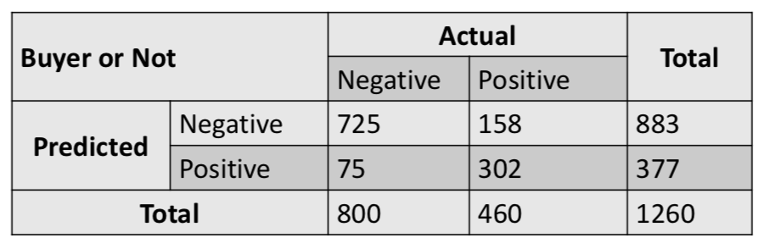
Buyer or non-buyer
A retail store’s marketing team uses analytics to predict who is likely to buy a newly introduced high-end (read “expensive”) product. Indicate which measure is more important for the business to track and explain why. Calculate other measures also.
Notes:
Attribute 1: (qualitative) Status of existing checking account A11 : ... < 0 DM A12 : 0 <= ... < 200 DM A13 : ... >= 200 DM / salary assignments for at least 1 year A14 : no checking account Attribute 2: (numerical) Duration in month Attribute 3: (qualitative) Credit history A30 : no credits taken/ all credits paid back duly A31 : all credits at this bank paid back duly A32 : existing credits paid back duly till now A33 : delay in paying off in the past A34 : critical account/ other credits existing (not at this bank) Attribute 4: (qualitative) Purpose A40 : car (new) A41 : car (used) A42 : furniture/equipment A43 : radio/television A44 : domestic appliances A45 : repairs A46 : education A47 : (vacation - does not exist?) A48 : retraining A49 : business A410 : others Attribute 5: (numerical) Credit amount Attibute 6: (qualitative) Savings account/bonds A61 : ... < 100 DM A62 : 100 <= ... < 500 DM A63 : 500 <= ... < 1000 DM A64 : .. >= 1000 DM A65 : unknown/ no savings account Attribute 7: (qualitative) Present employment since A71 : unemployed A72 : ... < 1 year A73 : 1 <= ... < 4 years A74 : 4 <= ... < 7 years A75 : .. >= 7 years Attribute 8: (numerical) Installment rate in percentage of disposable income Attribute 9: (qualitative) Personal status and sex A91 : male : divorced/separated A92 : female : divorced/separated/married A93 : male : single A94 : male : married/widowed A95 : female : single Attribute 10: (qualitative) Other debtors / guarantors A101 : none A102 : co-applicant A103 : guarantor Attribute 11: (numerical) Present residence since Attribute 12: (qualitative) Property A121 : real estate A122 : if not A121 : building society savings agreement/ life insurance A123 : if not A121/A122 : car or other, not in attribute 6 A124 : unknown / no property Attribute 13: (numerical) Age in years Attribute 14: (qualitative) Other installment plans A141 : bank A142 : stores A143 : none Attribute 15: (qualitative) Housing A151 : rent A152 : own A153 : for free Attribute 16: (numerical) Number of existing credits at this bank Attribute 17: (qualitative) Job A171 : unemployed/ unskilled - non-resident A172 : unskilled - resident A173 : skilled employee / official A174 : management/ self-employed/ highly qualified employee/ officer Attribute 18: (numerical) Number of people being liable to provide maintenance for Attribute 19: (qualitative) Telephone A191 : none A192 : yes, registered under the customers name Attribute 20: (qualitative) foreign worker A201 : yes A202 : no

Slide 47
Confusion Matrix
Buyer or Non-Buyer
State/Calculate:
TP = 302 TN = 725 FP = 75 FN = 158
Should the business be more worried about FP or FN or equally worried about both of them? Why?
FN. If the model predicts that the person will not buy, the product will not be marketed to him/her, and the business will lose...er, business.
FP is not such a big worry since only the cost of a phone call, SMS or sending a catalog will be lost.
Notes:
Attribute 1: (qualitative) Status of existing checking account A11 : ... < 0 DM A12 : 0 <= ... < 200 DM A13 : ... >= 200 DM / salary assignments for at least 1 year A14 : no checking account Attribute 2: (numerical) Duration in month Attribute 3: (qualitative) Credit history A30 : no credits taken/ all credits paid back duly A31 : all credits at this bank paid back duly A32 : existing credits paid back duly till now A33 : delay in paying off in the past A34 : critical account/ other credits existing (not at this bank) Attribute 4: (qualitative) Purpose A40 : car (new) A41 : car (used) A42 : furniture/equipment A43 : radio/television A44 : domestic appliances A45 : repairs A46 : education A47 : (vacation - does not exist?) A48 : retraining A49 : business A410 : others Attribute 5: (numerical) Credit amount Attibute 6: (qualitative) Savings account/bonds A61 : ... < 100 DM A62 : 100 <= ... < 500 DM A63 : 500 <= ... < 1000 DM A64 : .. >= 1000 DM A65 : unknown/ no savings account Attribute 7: (qualitative) Present employment since A71 : unemployed A72 : ... < 1 year A73 : 1 <= ... < 4 years A74 : 4 <= ... < 7 years A75 : .. >= 7 years Attribute 8: (numerical) Installment rate in percentage of disposable income Attribute 9: (qualitative) Personal status and sex A91 : male : divorced/separated A92 : female : divorced/separated/married A93 : male : single A94 : male : married/widowed A95 : female : single Attribute 10: (qualitative) Other debtors / guarantors A101 : none A102 : co-applicant A103 : guarantor Attribute 11: (numerical) Present residence since Attribute 12: (qualitative) Property A121 : real estate A122 : if not A121 : building society savings agreement/ life insurance A123 : if not A121/A122 : car or other, not in attribute 6 A124 : unknown / no property Attribute 13: (numerical) Age in years Attribute 14: (qualitative) Other installment plans A141 : bank A142 : stores A143 : none Attribute 15: (qualitative) Housing A151 : rent A152 : own A153 : for free Attribute 16: (numerical) Number of existing credits at this bank Attribute 17: (qualitative) Job A171 : unemployed/ unskilled - non-resident A172 : unskilled - resident A173 : skilled employee / official A174 : management/ self-employed/ highly qualified employee/ officer Attribute 18: (numerical) Number of people being liable to provide maintenance for Attribute 19: (qualitative) Telephone A191 : none A192 : yes, registered under the customers name Attribute 20: (qualitative) foreign worker A201 : yes A202 : no

Slide 48
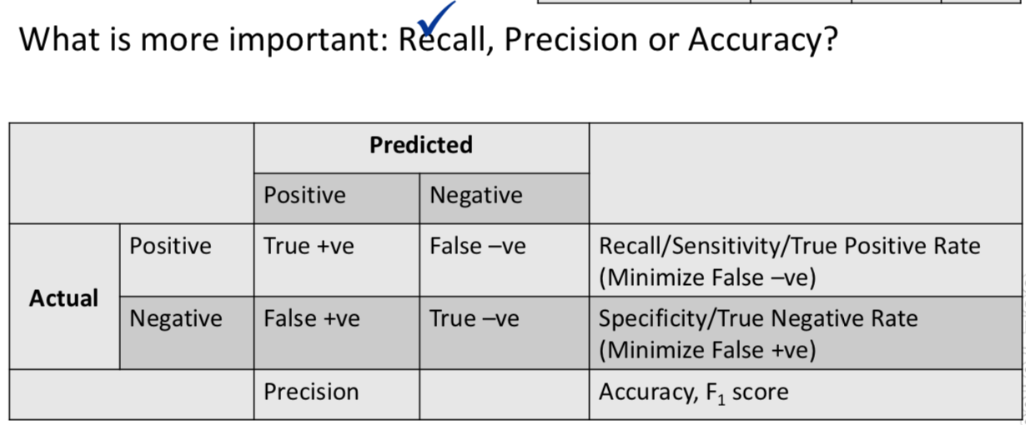
Confusion Matrix
Notes:
Attribute 1: (qualitative) Status of existing checking account A11 : ... < 0 DM A12 : 0 <= ... < 200 DM A13 : ... >= 200 DM / salary assignments for at least 1 year A14 : no checking account Attribute 2: (numerical) Duration in month Attribute 3: (qualitative) Credit history A30 : no credits taken/ all credits paid back duly A31 : all credits at this bank paid back duly A32 : existing credits paid back duly till now A33 : delay in paying off in the past A34 : critical account/ other credits existing (not at this bank) Attribute 4: (qualitative) Purpose A40 : car (new) A41 : car (used) A42 : furniture/equipment A43 : radio/television A44 : domestic appliances A45 : repairs A46 : education A47 : (vacation - does not exist?) A48 : retraining A49 : business A410 : others Attribute 5: (numerical) Credit amount Attibute 6: (qualitative) Savings account/bonds A61 : ... < 100 DM A62 : 100 <= ... < 500 DM A63 : 500 <= ... < 1000 DM A64 : .. >= 1000 DM A65 : unknown/ no savings account Attribute 7: (qualitative) Present employment since A71 : unemployed A72 : ... < 1 year A73 : 1 <= ... < 4 years A74 : 4 <= ... < 7 years A75 : .. >= 7 years Attribute 8: (numerical) Installment rate in percentage of disposable income Attribute 9: (qualitative) Personal status and sex A91 : male : divorced/separated A92 : female : divorced/separated/married A93 : male : single A94 : male : married/widowed A95 : female : single Attribute 10: (qualitative) Other debtors / guarantors A101 : none A102 : co-applicant A103 : guarantor Attribute 11: (numerical) Present residence since Attribute 12: (qualitative) Property A121 : real estate A122 : if not A121 : building society savings agreement/ life insurance A123 : if not A121/A122 : car or other, not in attribute 6 A124 : unknown / no property Attribute 13: (numerical) Age in years Attribute 14: (qualitative) Other installment plans A141 : bank A142 : stores A143 : none Attribute 15: (qualitative) Housing A151 : rent A152 : own A153 : for free Attribute 16: (numerical) Number of existing credits at this bank Attribute 17: (qualitative) Job A171 : unemployed/ unskilled - non-resident A172 : unskilled - resident A173 : skilled employee / official A174 : management/ self-employed/ highly qualified employee/ officer Attribute 18: (numerical) Number of people being liable to provide maintenance for Attribute 19: (qualitative) Telephone A191 : none A192 : yes, registered under the customers name Attribute 20: (qualitative) foreign worker A201 : yes A202 : no

Slide 49
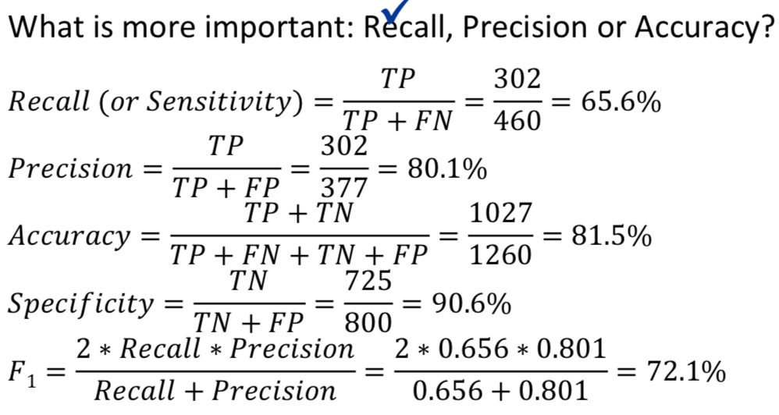
Confusion Matrix
Notes:
Attribute 1: (qualitative) Status of existing checking account A11 : ... < 0 DM A12 : 0 <= ... < 200 DM A13 : ... >= 200 DM / salary assignments for at least 1 year A14 : no checking account Attribute 2: (numerical) Duration in month Attribute 3: (qualitative) Credit history A30 : no credits taken/ all credits paid back duly A31 : all credits at this bank paid back duly A32 : existing credits paid back duly till now A33 : delay in paying off in the past A34 : critical account/ other credits existing (not at this bank) Attribute 4: (qualitative) Purpose A40 : car (new) A41 : car (used) A42 : furniture/equipment A43 : radio/television A44 : domestic appliances A45 : repairs A46 : education A47 : (vacation - does not exist?) A48 : retraining A49 : business A410 : others Attribute 5: (numerical) Credit amount Attibute 6: (qualitative) Savings account/bonds A61 : ... < 100 DM A62 : 100 <= ... < 500 DM A63 : 500 <= ... < 1000 DM A64 : .. >= 1000 DM A65 : unknown/ no savings account Attribute 7: (qualitative) Present employment since A71 : unemployed A72 : ... < 1 year A73 : 1 <= ... < 4 years A74 : 4 <= ... < 7 years A75 : .. >= 7 years Attribute 8: (numerical) Installment rate in percentage of disposable income Attribute 9: (qualitative) Personal status and sex A91 : male : divorced/separated A92 : female : divorced/separated/married A93 : male : single A94 : male : married/widowed A95 : female : single Attribute 10: (qualitative) Other debtors / guarantors A101 : none A102 : co-applicant A103 : guarantor Attribute 11: (numerical) Present residence since Attribute 12: (qualitative) Property A121 : real estate A122 : if not A121 : building society savings agreement/ life insurance A123 : if not A121/A122 : car or other, not in attribute 6 A124 : unknown / no property Attribute 13: (numerical) Age in years Attribute 14: (qualitative) Other installment plans A141 : bank A142 : stores A143 : none Attribute 15: (qualitative) Housing A151 : rent A152 : own A153 : for free Attribute 16: (numerical) Number of existing credits at this bank Attribute 17: (qualitative) Job A171 : unemployed/ unskilled - non-resident A172 : unskilled - resident A173 : skilled employee / official A174 : management/ self-employed/ highly qualified employee/ officer Attribute 18: (numerical) Number of people being liable to provide maintenance for Attribute 19: (qualitative) Telephone A191 : none A192 : yes, registered under the customers name Attribute 20: (qualitative) foreign worker A201 : yes A202 : no

Slide 50
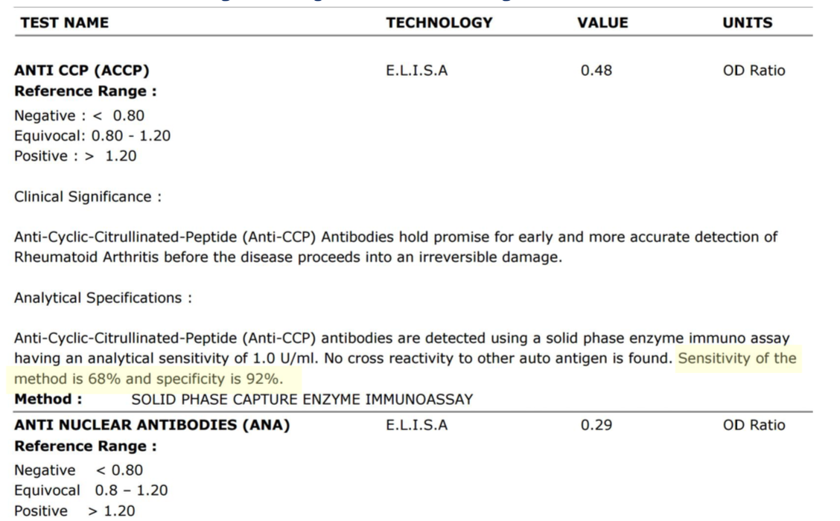
Sensitivity - Specificity

Slide 51

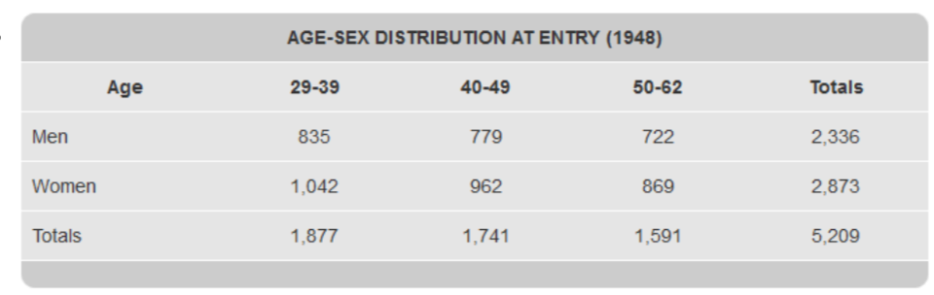
Case – Framingham Heart Study
Committed to identifying common factors contributing to cardiovascular disease (CVD).
Setup in the town of Framingham, MA in 1948
Random sample consisting of 2/3rds of adult population in the town

Slide 52
Case Study: Data (framinghamheartstudy.org & MITx)
5209 men and women participated
Age range: 30-62
People who had not yet developed overt symptoms of CVD or suffered a heart attack or stroke
Careful monitoring of Framingham Study population has led to identification of major CVD risk factors
Led to development of Framingham Risk Score, a gender specific algorithm used to estimate the 10-year cardiovascular risk of an individual
http://cvdrisk.nhlbi.nih.gov/

Slide 53
Case Study – Predicting Coronary Heart Disease (CHD)
Data description 4240 observations; 15 predictor and 1 predicted variables
TenYearCHD – To be predicted. Risk of having a heart attack or stroke in the next 10 years.
Predictors
Demographic Risk Factors
– male: Gender of subject – Yes or No
– age: Age of subject at first examination
– education: some high school (1), high school (2), some college/vocational college (3), college (4)

Slide 54
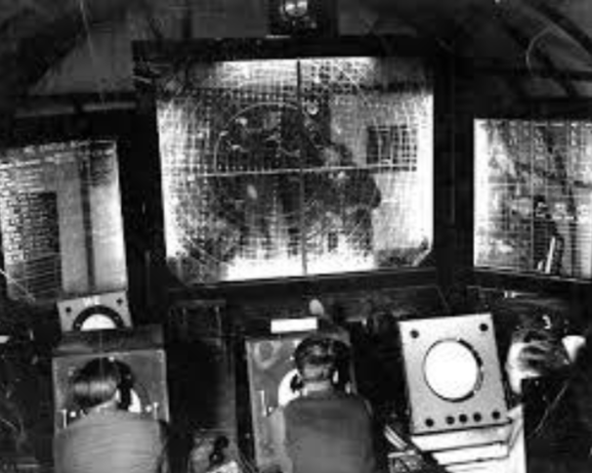
ROC Curves and AUC
ROC – Receiver Operating Characteristics
AUC – Area Under the ROC Curve

Slide 55
ROC Curves and AUC
Logistic regression gives Probability forecasts for the given data point to be in a given bucket. • A threshold needs to be chosen to finally translate this probability to a bucket allocation
At a given threshold, we can evaluate the classification accuracy (accuracy, sensitivity, recall, kappa etc)
ROC curve tries to evaluate how well the regression has achieved the separation between the classes at all threshold values

Slide 56
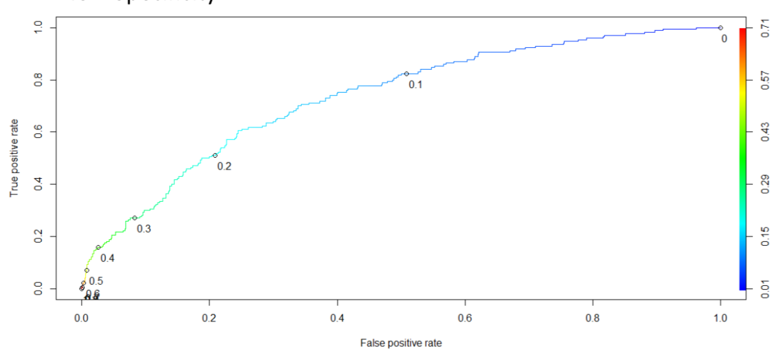
ROC Curves and AUC
ROC – Plot of True Positive Rate vs False Positive Rate, i.e., Sensitivity vs 1-Specificity

Slide 57
ROC Curves and AUC
AUC – Measures discrimination, i.e., ability to correctly classify those with and without CHD
If you randomly pick one person who HAS CHD and one who DOESN’T and run the model, the one with the higher probability should be from the high risk group
AUC is the percentage of randomly drawn such pairs for which the classification is done correctly

Slide 58
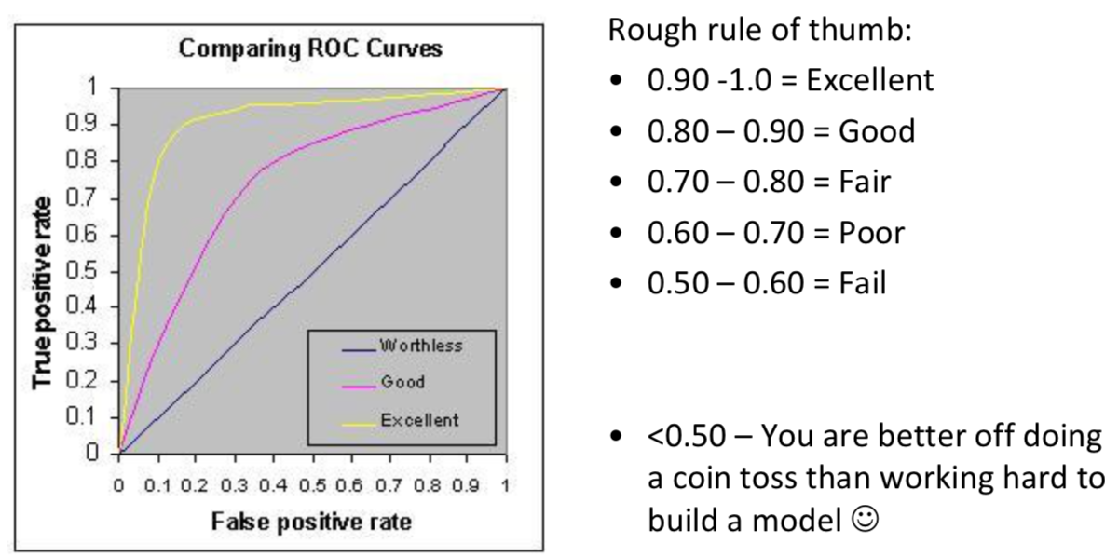
ROC Curves and AUC

Slide 59
ROC Curve Demo
http://www.navan.name/roc/
https://youtu.be/OAl6eAyP-yo

Slide 60
Kappa Metric
Accuracy can often be a misleading metric, when one category occurs more often than other in the given data-set
e.g: Occurrence of cancer in general population is 0.4%
If a prediction system blindly marks everyone as “No cancer”, it will 99.6% accurate

Slide 61
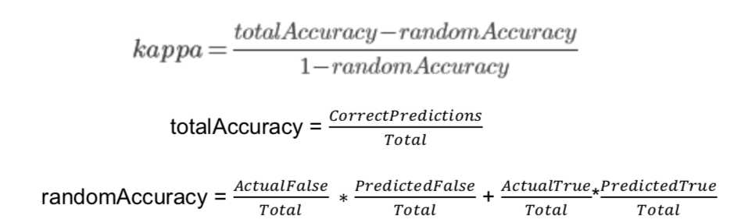
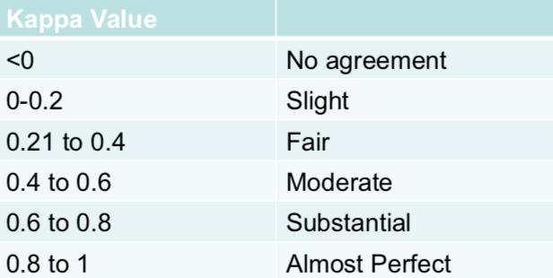
Kappa Metric
Quantifies how accurate the prediction algorithm is when compared to a random prediction

Slide 62
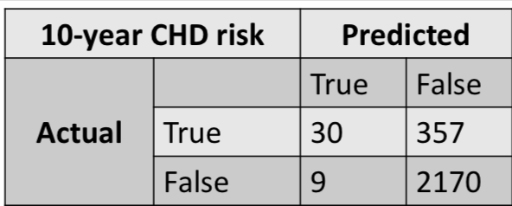
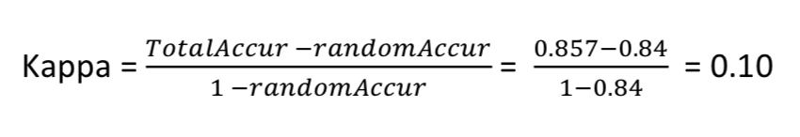
Kappa Metric
Total= 30+357+9+2170=2566
TotalAccuracy=(30+2170)/2566=0.857
PercTrue=(30+357)/2566 = 0.15; PercFalse=(9+2170)/2566 = 0.85
PredTrue=(30+9)/2566=0.015; PredFalse=(357+2170)/2566 = 0.985
randomAccuracy= 0.15*0.015 + 0.85*0.985 = 0.84
Slightly better than random!

Slide 63

Actuarial Statistics is a huge industry with market potential of over ~200 Billion/year. LIC has released a new product (“Yuva Jeevan”) and has hired you as Machine Learning Engineer to predict the average claim per year. We have a single attribute (age). How do we go about this?
Notes:
Attribute 1: (qualitative) Status of existing checking account A11 : ... < 0 DM A12 : 0 <= ... < 200 DM A13 : ... >= 200 DM / salary assignments for at least 1 year A14 : no checking account Attribute 2: (numerical) Duration in month Attribute 3: (qualitative) Credit history A30 : no credits taken/ all credits paid back duly A31 : all credits at this bank paid back duly A32 : existing credits paid back duly till now A33 : delay in paying off in the past A34 : critical account/ other credits existing (not at this bank) Attribute 4: (qualitative) Purpose A40 : car (new) A41 : car (used) A42 : furniture/equipment A43 : radio/television A44 : domestic appliances A45 : repairs A46 : education A47 : (vacation - does not exist?) A48 : retraining A49 : business A410 : others Attribute 5: (numerical) Credit amount Attibute 6: (qualitative) Savings account/bonds A61 : ... < 100 DM A62 : 100 <= ... < 500 DM A63 : 500 <= ... < 1000 DM A64 : .. >= 1000 DM A65 : unknown/ no savings account Attribute 7: (qualitative) Present employment since A71 : unemployed A72 : ... < 1 year A73 : 1 <= ... < 4 years A74 : 4 <= ... < 7 years A75 : .. >= 7 years Attribute 8: (numerical) Installment rate in percentage of disposable income Attribute 9: (qualitative) Personal status and sex A91 : male : divorced/separated A92 : female : divorced/separated/married A93 : male : single A94 : male : married/widowed A95 : female : single Attribute 10: (qualitative) Other debtors / guarantors A101 : none A102 : co-applicant A103 : guarantor Attribute 11: (numerical) Present residence since Attribute 12: (qualitative) Property A121 : real estate A122 : if not A121 : building society savings agreement/ life insurance A123 : if not A121/A122 : car or other, not in attribute 6 A124 : unknown / no property Attribute 13: (numerical) Age in years Attribute 14: (qualitative) Other installment plans A141 : bank A142 : stores A143 : none Attribute 15: (qualitative) Housing A151 : rent A152 : own A153 : for free Attribute 16: (numerical) Number of existing credits at this bank Attribute 17: (qualitative) Job A171 : unemployed/ unskilled - non-resident A172 : unskilled - resident A173 : skilled employee / official A174 : management/ self-employed/ highly qualified employee/ officer Attribute 18: (numerical) Number of people being liable to provide maintenance for Attribute 19: (qualitative) Telephone A191 : none A192 : yes, registered under the customers name Attribute 20: (qualitative) foreign worker A201 : yes A202 : no

Slide 64
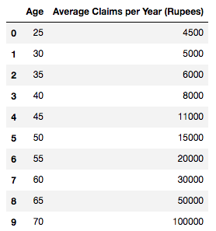
Demo
1000 rows X 2 columns
No missing values
http://localhost:8888/notebooks/Downloads/DT_RF_Regression.ipynb
Notes:
Attribute 1: (qualitative) Status of existing checking account A11 : ... < 0 DM A12 : 0 <= ... < 200 DM A13 : ... >= 200 DM / salary assignments for at least 1 year A14 : no checking account Attribute 2: (numerical) Duration in month Attribute 3: (qualitative) Credit history A30 : no credits taken/ all credits paid back duly A31 : all credits at this bank paid back duly A32 : existing credits paid back duly till now A33 : delay in paying off in the past A34 : critical account/ other credits existing (not at this bank) Attribute 4: (qualitative) Purpose A40 : car (new) A41 : car (used) A42 : furniture/equipment A43 : radio/television A44 : domestic appliances A45 : repairs A46 : education A47 : (vacation - does not exist?) A48 : retraining A49 : business A410 : others Attribute 5: (numerical) Credit amount Attibute 6: (qualitative) Savings account/bonds A61 : ... < 100 DM A62 : 100 <= ... < 500 DM A63 : 500 <= ... < 1000 DM A64 : .. >= 1000 DM A65 : unknown/ no savings account Attribute 7: (qualitative) Present employment since A71 : unemployed A72 : ... < 1 year A73 : 1 <= ... < 4 years A74 : 4 <= ... < 7 years A75 : .. >= 7 years Attribute 8: (numerical) Installment rate in percentage of disposable income Attribute 9: (qualitative) Personal status and sex A91 : male : divorced/separated A92 : female : divorced/separated/married A93 : male : single A94 : male : married/widowed A95 : female : single Attribute 10: (qualitative) Other debtors / guarantors A101 : none A102 : co-applicant A103 : guarantor Attribute 11: (numerical) Present residence since Attribute 12: (qualitative) Property A121 : real estate A122 : if not A121 : building society savings agreement/ life insurance A123 : if not A121/A122 : car or other, not in attribute 6 A124 : unknown / no property Attribute 13: (numerical) Age in years Attribute 14: (qualitative) Other installment plans A141 : bank A142 : stores A143 : none Attribute 15: (qualitative) Housing A151 : rent A152 : own A153 : for free Attribute 16: (numerical) Number of existing credits at this bank Attribute 17: (qualitative) Job A171 : unemployed/ unskilled - non-resident A172 : unskilled - resident A173 : skilled employee / official A174 : management/ self-employed/ highly qualified employee/ officer Attribute 18: (numerical) Number of people being liable to provide maintenance for Attribute 19: (qualitative) Telephone A191 : none A192 : yes, registered under the customers name Attribute 20: (qualitative) foreign worker A201 : yes A202 : no

Slide 65
Decision Tree (Excercises):
Lab_1 Decision Tree based model to predict class of wines
Lab_2 Build a decision tree model for Pima Diabetes dataset to predict diabetic cases
Notes:
Its loved by the industry! (Because?)
An ensemble method of Decision Trees called Random Forest can model most tabular data incredibly well so much so that some courses only teach Random Forest
Source: www.fast.ai
Sol: DecisionTree_Wine.ipynb
Notes:
Attribute 1: (qualitative) Status of existing checking account A11 : ... < 0 DM A12 : 0 <= ... < 200 DM A13 : ... >= 200 DM / salary assignments for at least 1 year A14 : no checking account Attribute 2: (numerical) Duration in month Attribute 3: (qualitative) Credit history A30 : no credits taken/ all credits paid back duly A31 : all credits at this bank paid back duly A32 : existing credits paid back duly till now A33 : delay in paying off in the past A34 : critical account/ other credits existing (not at this bank) Attribute 4: (qualitative) Purpose A40 : car (new) A41 : car (used) A42 : furniture/equipment A43 : radio/television A44 : domestic appliances A45 : repairs A46 : education A47 : (vacation - does not exist?) A48 : retraining A49 : business A410 : others Attribute 5: (numerical) Credit amount Attibute 6: (qualitative) Savings account/bonds A61 : ... < 100 DM A62 : 100 <= ... < 500 DM A63 : 500 <= ... < 1000 DM A64 : .. >= 1000 DM A65 : unknown/ no savings account Attribute 7: (qualitative) Present employment since A71 : unemployed A72 : ... < 1 year A73 : 1 <= ... < 4 years A74 : 4 <= ... < 7 years A75 : .. >= 7 years Attribute 8: (numerical) Installment rate in percentage of disposable income Attribute 9: (qualitative) Personal status and sex A91 : male : divorced/separated A92 : female : divorced/separated/married A93 : male : single A94 : male : married/widowed A95 : female : single Attribute 10: (qualitative) Other debtors / guarantors A101 : none A102 : co-applicant A103 : guarantor Attribute 11: (numerical) Present residence since Attribute 12: (qualitative) Property A121 : real estate A122 : if not A121 : building society savings agreement/ life insurance A123 : if not A121/A122 : car or other, not in attribute 6 A124 : unknown / no property Attribute 13: (numerical) Age in years Attribute 14: (qualitative) Other installment plans A141 : bank A142 : stores A143 : none Attribute 15: (qualitative) Housing A151 : rent A152 : own A153 : for free Attribute 16: (numerical) Number of existing credits at this bank Attribute 17: (qualitative) Job A171 : unemployed/ unskilled - non-resident A172 : unskilled - resident A173 : skilled employee / official A174 : management/ self-employed/ highly qualified employee/ officer Attribute 18: (numerical) Number of people being liable to provide maintenance for Attribute 19: (qualitative) Telephone A191 : none A192 : yes, registered under the customers name Attribute 20: (qualitative) foreign worker A201 : yes A202 : no

Slide 66

Thank you! Questions?
Jayanth Rasamsetti
Founder & Chief Scientist
www.sgmoid.com
Columbia University (MS)
IIT Madras (B.Tech & M.Tech)
jr3281@columbia.edu
https://www.linkedin.com/in/jayanthr/

